Slide 1
Health Copilot
Stephen Durham, Eric Eldridge, Justin Essian, Brian Rossman
Notes:
INTRODUCE PEOPLE HERE

Slide 2
Introduction
Scope
Project Requirements
Iterations
Future Changes
Design Elements
Models
Views
Controllers
Lessons Learned
Team Contribution
Notes:
UPDATE TO REFLECT PG 42 OF 14.1

Slide 3
Project Scope
Add recipe
Add by text, URL, and scanned input
Parse raw input into title, ingredients, instructions
Schedule recipes from user and shared database
Manage food inventory
Generate shopping list
Create list based on scheduled meals and current inventory
Price compare

Slide 4
Project Requirements
List Recipes MVC Module
Favorite
Recently added
Most used
Recipe Toolbox MVC Module
Scheduling MVC Module
Upcoming Meals MVC Module
User Account MVC Module
Notes:
DESCRIBE WHAT WE PLAN TO IMPLEMENT
DESCRIBE MAIN VIEW AND CONCEPT BEHIND APPLICATION

Slide 5
Recipes MVC Module
Implements CRUD operations for Recipes
Create
Retrieve
Update
Delete
Displays All Recipes
Contains two views
All recipes
Favorite and Recent recipes
Most recent/favorite meals are determined by scheduling frequency
Amount of times a user has scheduled that meal within the calendar module
Notes:
THIS IS A VISUAL VIEW. ITS PRIMARY FUNCTION IS TO DISPLAY ALL OF OUR RECIPES.
CONTAINS TWO TYPES OF VIEWS, ALL RECIPES AND (FAVORITE AND RECENT MEALS).

Slide 6
Recipe MVC Module
Handles adding a new recipe to user accounts
Allows existing recipe manipulation
update or delete recipes
Notes:
IT JUST CONTAINS AN ADD NEW RECIPE BUTTON
LINKS TO AN ADD RECIPE FORM

Slide 7
Scheduling MVC Module
Handles all meal scheduling
User may update, schedule, and delete events on their calendar
Maintains scheduled events within a calendar view
The calendar defaults to the current day
The calendar responds to user click events
Displays meals scheduled for the day
Notes:
CONTAINS A FORM FOR USERS TO ADD, UPDATE, AND DELETE EVENTS
IF YOU CLICK ON A DAY, IT BRINGS UP THE SCHEDULED EVENTS FOR THAT DAY, IF ANY.

Slide 8
Upcoming Meals MVC Module
Display meal events for current or future days
Current day events are automatically displayed below on initialization
Meal events can occur at 3 different time intervals per day
Breakfast, lunch, dinner
Notes:
EXTENDED FUNCTIONALITY OF SCHEDULING
ALL EVENTS ARE DISPLAYED BELOW THE CALENDAR

Slide 9
User Account MVC Module
Handles user creation, log in, and log out
Necessary for security reasons and for session tracking
Requires a valid username and password
Failed login attempt redirects users to the login/create account page
Notes:
BASIC USER LOG IN AND USER MANAGEMENT MODULE.
HANDLES ALL SESSION TRACKING, USER CREATION, AND MAINTAINENCE OF USER PROFILE

Slide 10
Iteration 1
Setup Github
Required 14 man hours to add empty application to Github with ruby mine integration
12 more hours than anticipated
Setup Bootstrap
User Account MVC Module
Add recipe MVC Module

Slide 11
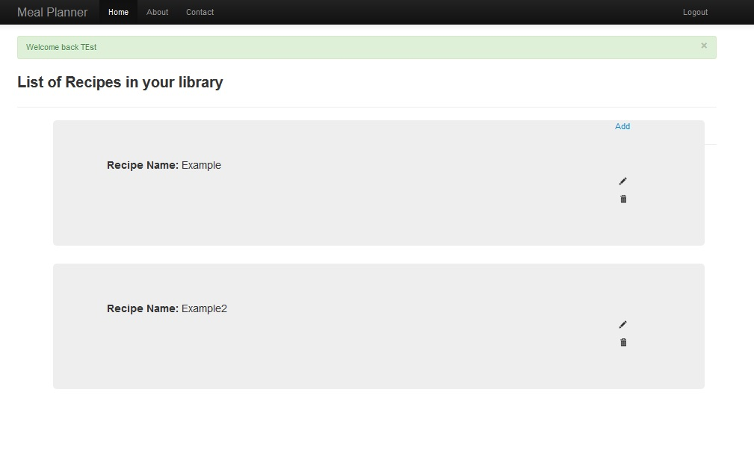
ITERATION 1 DEMO

Slide 12
Iteration 2
Recipe toolbox module
Add Recipe
List Recipe
Calendar module
(pushed to iteration 3)
Upcoming meals module
(pushed to iteration 3)
Main View
Integrate modules within view

Slide 13
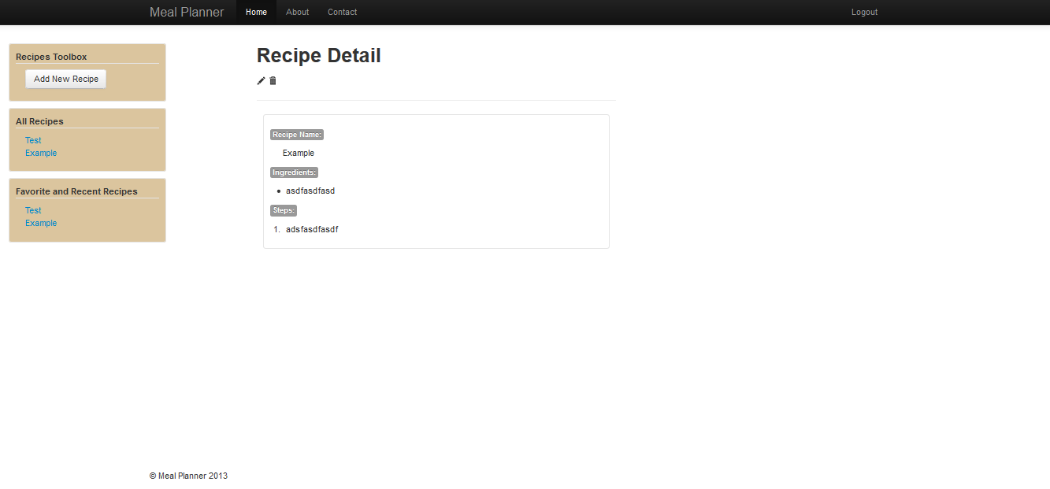
ITERATION 2 DEMO

Slide 14
Iteration 3
Calendar Module
Upcoming meals Module
Recently Added Module
Enhanced session interaction between all modules
Implemented Ajax and JavaScript within the calendar view

Slide 15
ITERATION 3 DEMO

Slide 16
Lessons Learned
Version control is a vital project management tool when working in small or large groups
Specifically, Git proved to be more problematic than helpful
Should have used iteration 1 to evaluate team members knowledge of ruby on rails
To correct any team member misconceptions
Iterations made it easier to judge progress
Using the model abstraction made database management easy
Rails is cleaner to implement than PHP

Slide 17
Team Contribution
Group
Setup project in Github
Project Documentation
Brian
Security and login views
Integration into main view
BDD scenarios on user id
Setup bootstrap
Steve
Recipe models and views
Recipe toolbox
Integration into the main view
BDD on recipes and scheduler

Slide 18
Team Contribution (continued)
Eric
Created main application view and CSS
Ajax/jQuery for the scheduler MVC Module
TDD on scheduler
Justin
Scheduler model
Calendar model
Ajax/jQuery for the scheduler MVC Module

Slide 19
Questions?

Slide 20
Future Changes
Account Management MVC Module
Most used recipes list
Parch recipe ingredients into discrete items
Search feature to quickly locate recipes
The system must prompt for user input for unrecognized words when adding a recipe
Users must be able to confirm unrecognized words

Slide 21
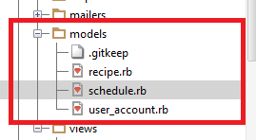
Models

Slide 22
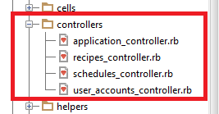
Controllers

Slide 23
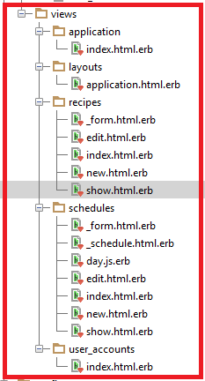
Views

